Slide 1
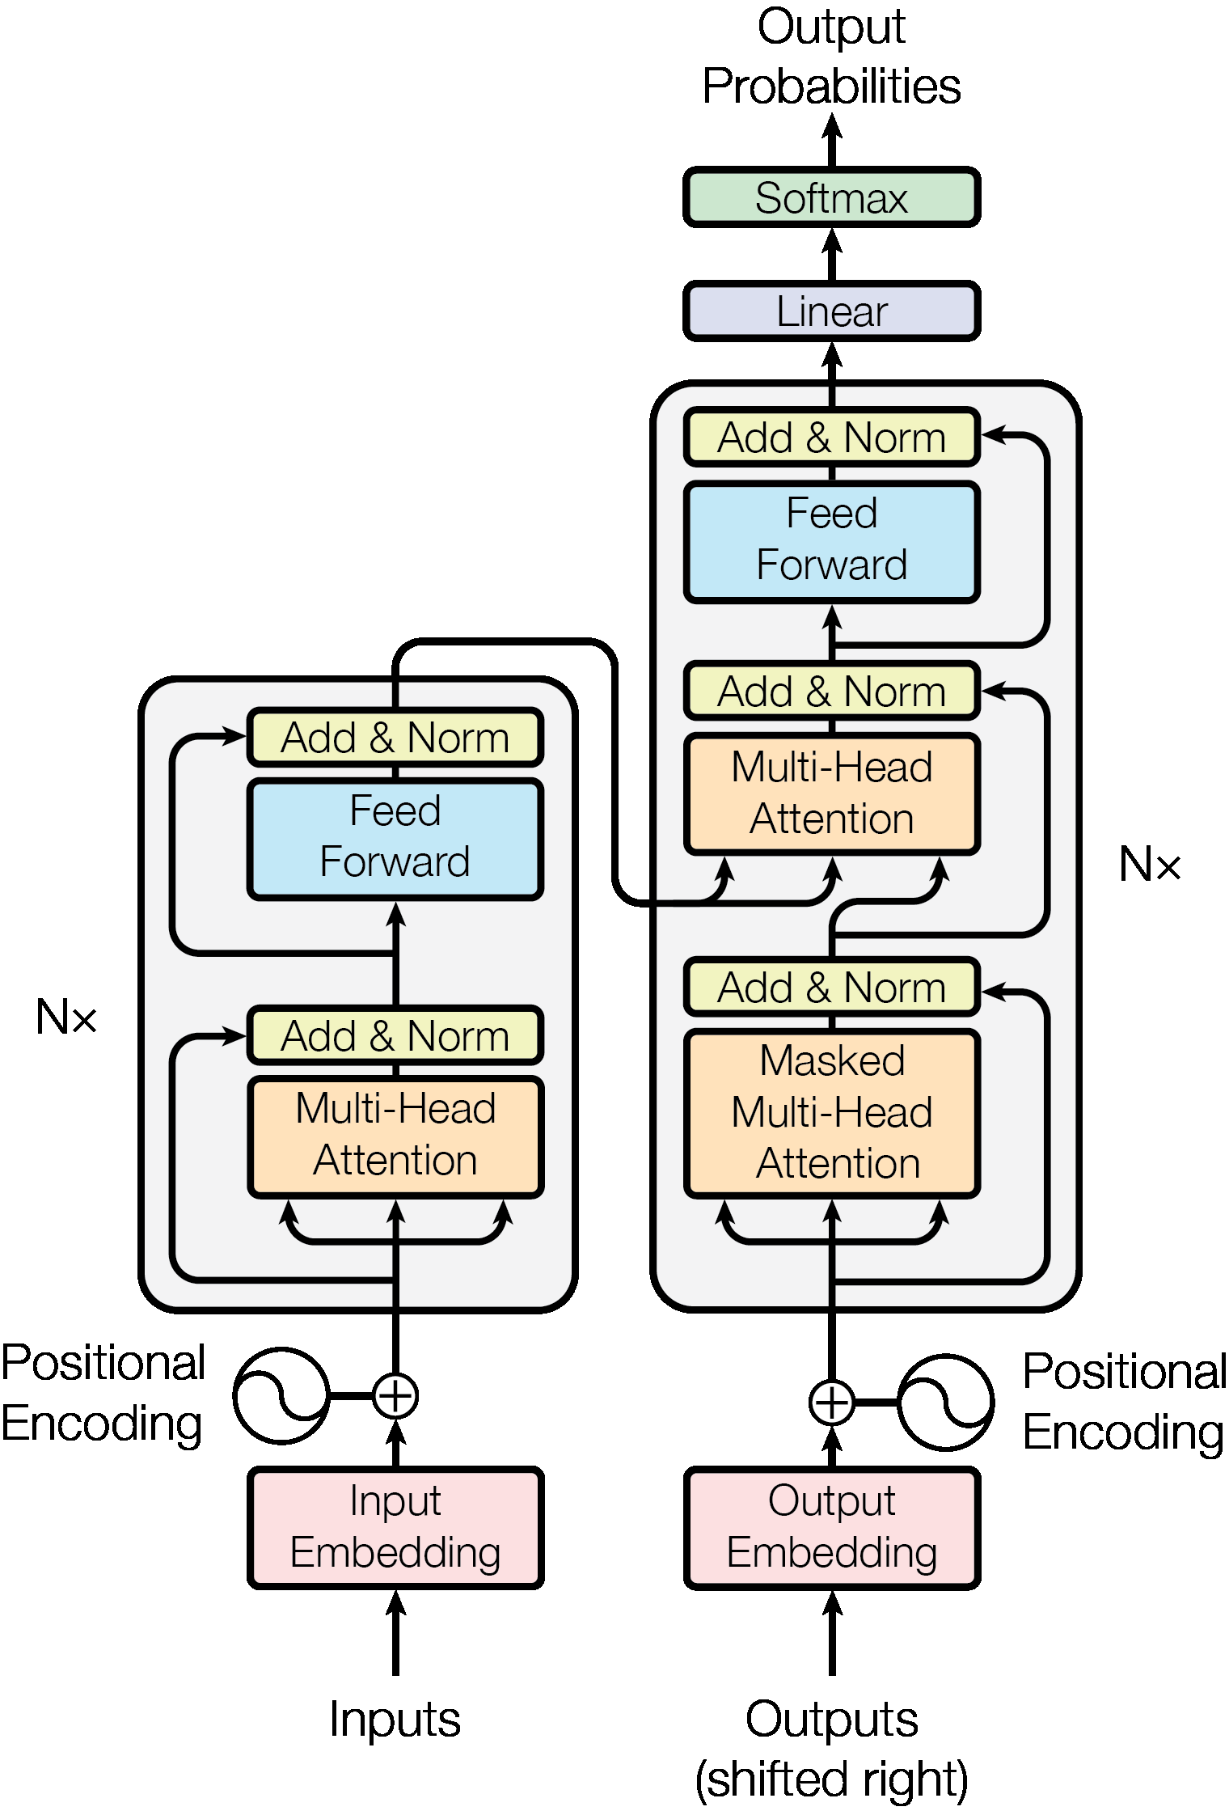
Attention is all you need
Authors
Ashish Vaswani, Noam Shazeer, Niki Parmar, et al.
Google Brain
Key Findings
Introduced the Transformer architecture using self-attention mechanisms, eliminating recurrence and convolutional layers.
Achieved state-of-the-art machine translation results with significantly faster training via parallel processing.
Demonstrated effective long-range dependency modeling through visualized attention patterns.

